Slide 1
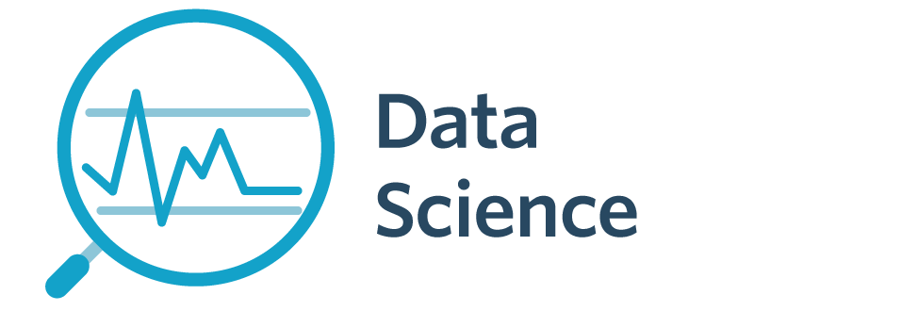

7143CEM Mini-lecture 3-2d: Hadoop Ecosystem
School of Computing, Electronics and Mathematics Coventry University
7143CEM Programming for Data Science 2021/22 Semester 1

Slide 2
Recap
Big Data: high volume/velocity/variety (+veracity, …)
Storage/processing: decreasing cost and increasing power/capacity/speed of processors/memory/storage
Horizontal scaling of storage/processing systems
distributed database (data splitting/replication), data centres
NoSQL (“Not only SQL”), unstructured data
Consistency, Availability, Partition tolerance (CAP theorem is that cannot guarantee all three under network failures)

Slide 3
Big Data “bullseye”
Scalable Performance
Operational Ease
Cost Effective

Slide 4
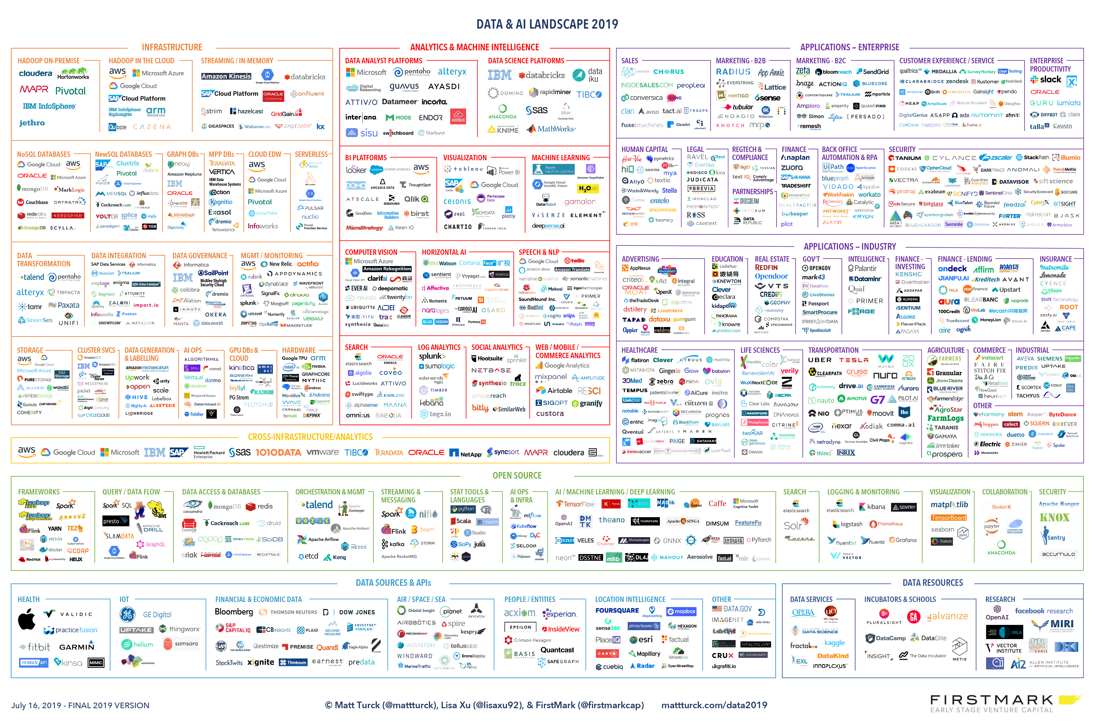
Tools: Data and AI Landscape
Notes:
Article: https://mattturck.com/data2019/
Full size image: http://mattturck.com/wp-content/uploads/2019/07/2019_Matt_Turck_Big_Data_Landscape_Final_Fullsize.png

Slide 5
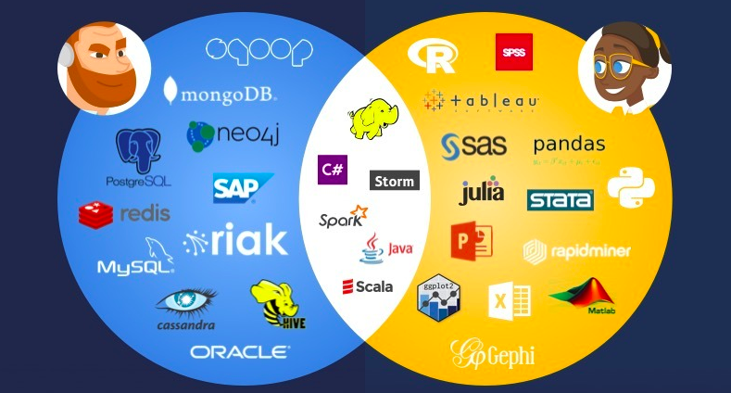
Tools: Data Engineer vs Data Scientist
Notes:
Reading: https://www.datacamp.com/community/blog/data-scientist-vs-data-engineer
Reading (MEAN stack): https://www.ibm.com/uk-en/cloud/learn/mean-stack-explained

Slide 6
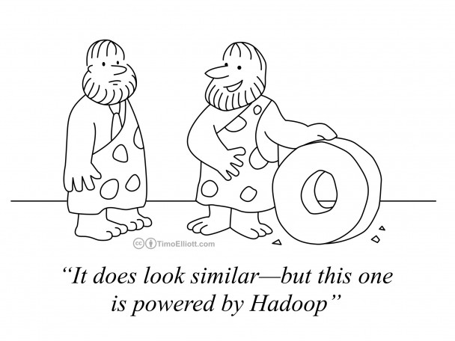

Apache Hadoop (2006)
Began in life in Google, Facebook and Yahoo.
Uses commodity hardware for storage and processing data
Open-source distribution https://hadoop.apache.org/
Notes:
Image from: https://timoelliott.com/blog/2014/04/cartoon-analytics-reinvention.html

Slide 7
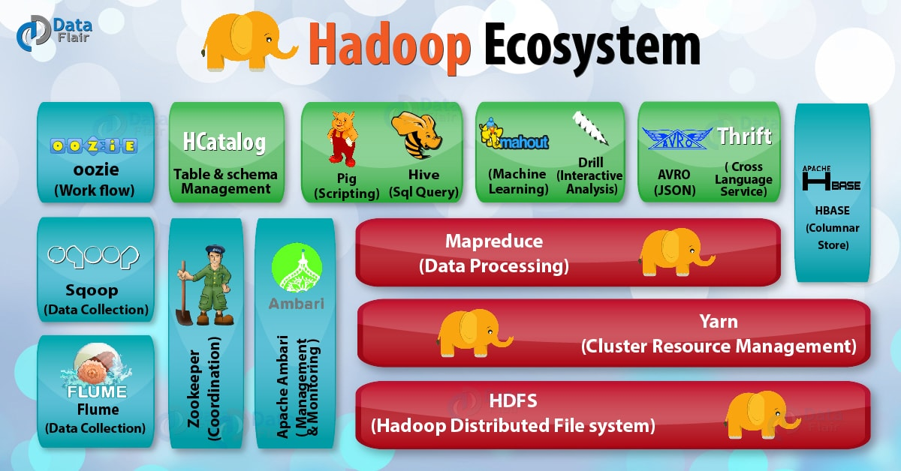
Here
Notes:
Image from: https://data-flair.training/blogs/hadoop-ecosystem-components/

Slide 8

Hadoop Distributed File System
HDFS is a scalable distributed file system
Spreads data files over many data nodes (cheap hardware)
Write once, read many times (CP)
Files split into blocks of 128MB, and blocks are replicated on at least three data nodes (two on same physical rack, one of a different physical rack)
Robust to data node failures
Notes:
Reading: https://intellipaat.com/blog/tutorial/hadoop-tutorial/hdfs-overview/

Slide 9

MapReduce
Problem: Apply to very large/distributed datasets
Geographical, satellites, database queries, huge organisations (think NHS)
Perhaps within a data centre (the “cloud”)
Approaches
(1) Copy the data
(2) Take the programmer to the data (wherever it is stored)

Slide 10
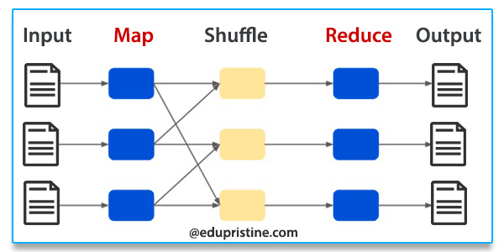
MapReduce
Example task: count songs/music files by genre
Mapper — apply a function to local data to produce key/value pairs (genre, count) from each input file
Reducer — combine all key/value pairs with the same key, e.g., Opera music
Parallelism via distributed processing (scheduler)
Notes:
Image from: https://www.edupristine.com/blog/hadoop-mapreduce-framework

Slide 11
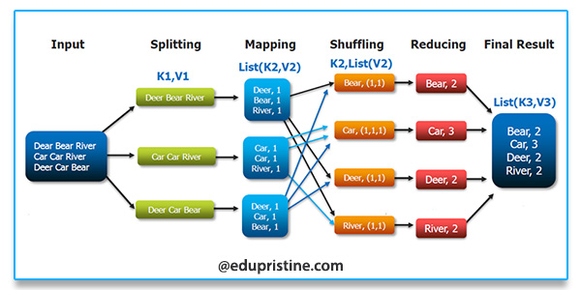
Another example
Notes:
Example from: https://www.edupristine.com/blog/hadoop-mapreduce-framework

Slide 12
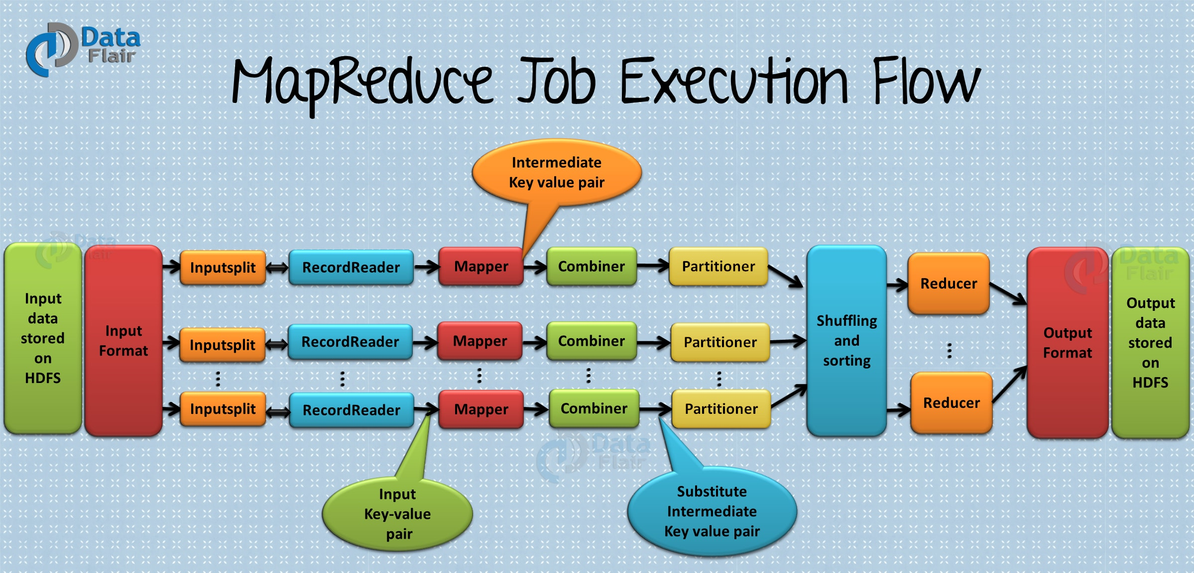
Notes:
Image from: https://data-flair.training/blogs/hadoop-ecosystem-components/

Slide 13
Apache Open Source Big Data Tools
Apache Hadoop http://hadoop.apache.org/
HDFS, MapReduce (batch processing), YARN (cluster scheduler)
Apache Spark http://spark.apache.org/ (also Tez, Flink, Pig)
General purpose cluster computing framework, including SQL and streaming data, via directed acyclic graph
Apache Storm http://storm.apache.org/ (also Samoa)
Real-time stream data processing (“spouts” and “bolts”), i.e., infinite datasets
Apache Cassandra http://cassandra.apache.org/
Distributed database
Notes:
Reading: https://www.whizlabs.com/blog/big-data-tools/

Slide 14
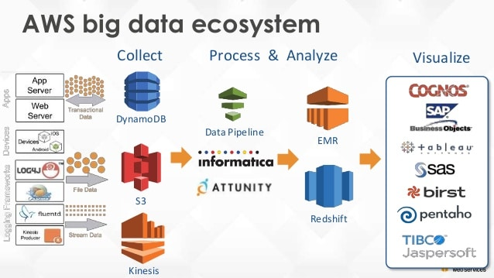
Amazon Web Services (AWS)
Notes:
Image from: https://dimensionless.in/top-5-advantages-of-aws-big-data-speciality/
DynamoDB (like Cassandra) is Available and Partition-tolerant (see https://blog.yugabyte.com/11-things-you-wish-you-knew-before-starting-with-dynamodb/)

Slide 15
Summary
Open-source Big Data technology
Apache Hadoop (HDFS, MapReduce, YARN)
Ecosystem of Big Data tools including Apache Spark, …
Used/developed by Facebook, Twitter, LinkedIn, Yahoo, Ebay, Adobe, Amazon, IBM, Marks and Spencer, Royal Mail, British Airways, Nokia, …
Notes:
Reading: https://kognitio.com/big-data/companies-using-hadoop-big-data-analytics/

Slide 16
Class Discussion Question
Recall the Square Kilometre Array of thousands of radio telescopes (planned to be built in Australia and South Africa).
Suppose that processing of the radio telescope data involves calculating correlations between data from nearby pairs of radio telescopes.
Outline how the radio telescope data could be stored and processed on a distributed cluster in a data centre (or the cloud).

